Slide 1
Blood Pressure Lowering and Thrombolysis: Concurrent vs Sequential Management in Acute Ischemic Stroke (BALANCE)
IIS
Leading PI - Prof. Wu Bo (West China Hospital); Bijoy K. Menon (University of Calgary, Canada)
For PEC Endorsement

Slide 2
Nearly 30% of AIS patients present with a SBP ≥180 mmHg
75.3% - 81.6% of patients with acute ischemic stroke (AIS) present with a systolic blood pressure(SBP) ≥140 mmHg¹
25.3% - 27.6% of patients with AIS present with a SBP ≥180 mmHg²⁻³
CAST (Chinese Acute Stroke Trial):
SBP in AIS (n=21,106)²
IST (International Stroke Trial)：
SBP in AIS (n=17,398)³
中华医学会神经病学分会, 中华医学会神经病学分会脑血管病学组. 中国急性缺血性卒中诊治指南2023. 中华神经科杂志 2024; 57: 523–559.
CAST(Chinese Acute Stroke Trial) Collaborative Group. Lancet. 1997; 349(9066):1641-9.
Leonardi-Bee J, et al. Stroke. 2002; 33(5):1315-20.

Slide 3
Current guidelines recommend BP＜180/100 mmHg prior to IVT however, there is no robust evidence for this strategy
Current guidelines recommendations for blood pressure management in AIS
Guidelines | Recommendations | Class (Strength) of Recommendation | Level (Quality) of Evidence
AHA/ASA-Guidelines for the Early Management of Patients With Acute Ischemic Stroke 2026¹ | Patients with AIS who have elevated BP and are otherwise eligible for treatment with IVT should have their SBP lowered to <185 mm Hg and DBP <110 mm Hg before IVT therapy is initiated to reduce hemorrhagic complications. | I | B-NR
European Stroke Organisation (ESO) guidelines on blood pressure management in acute ischaemic stroke and intracerebral haemorrhage 2021² | For patients with acute ischaemic stroke of<4.5 h duration, and with systolic blood pressure >185mm Hg or diastolic blood pressure >110mm Hg, which has subsequently been lowered to <185 and <110mm Hg, we recommend intravenous thrombolysis with alteplase. | Strong | Low
Chinese guidelines for diagnosis and treatment of acute ischemic stroke 2023³ | In patients scheduled for thrombolysis, systolic blood pressure should be lowered to <180 mmHg and diastolic blood pressure <100 mmHg; the exact target values require further study | I | B
NR: nonrandomized
Stroke. 2026;57:e00–e00. DOI: 10.1161/STR.0000000000000513
Sandset EC, et al. Eur Stroke J. 2021; 6(2):XLVIII-LXXXIX.
中华医学会神经病学分会, 中华医学会神经病学分会脑血管病学组. 中国急性缺血性卒中诊治指南2023. 中华神经科杂志 2024; 57: 523–559.
Notes:
Thus, without a clear benefit of 1 versus another strategy, it is reasonable to adhere to BP recommendations of the IVT clinical trial protocols.
Because several major RCTs of thrombectomy had preprocedural BP managed <185/110 mm Hg, it is reasonable to use this level as a guideline until additional data become available.

Slide 4


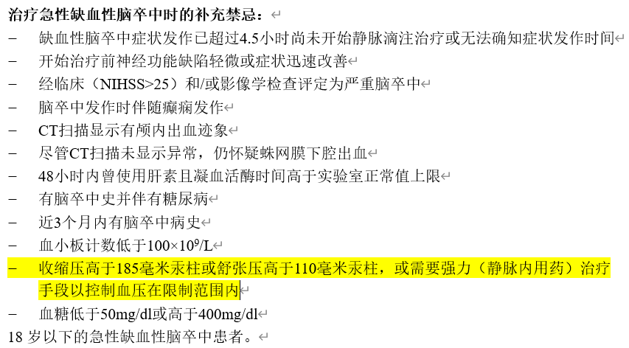
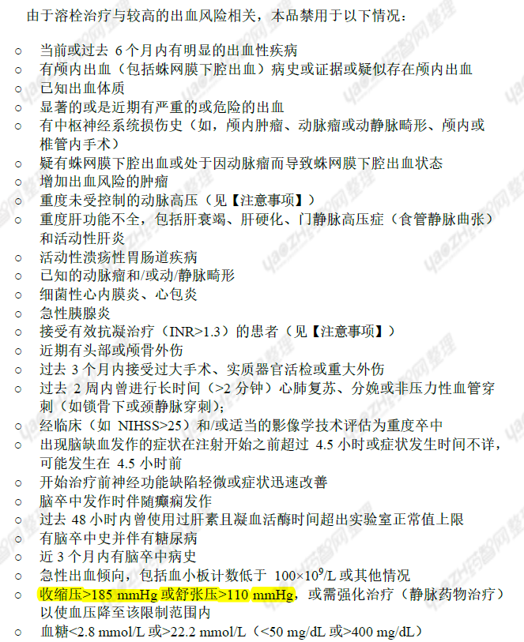
Metalyse / Actilyse contraindication for hypertension pts. with SBP＞185 or DBP ＞110 mmHg
阿替普酶说明书. 2025年01月07日
注射用替奈普酶说明书. 核准日期：2025年5月13日.
Notes:
Metalyse PI contraindication for hypertension pts

Slide 5
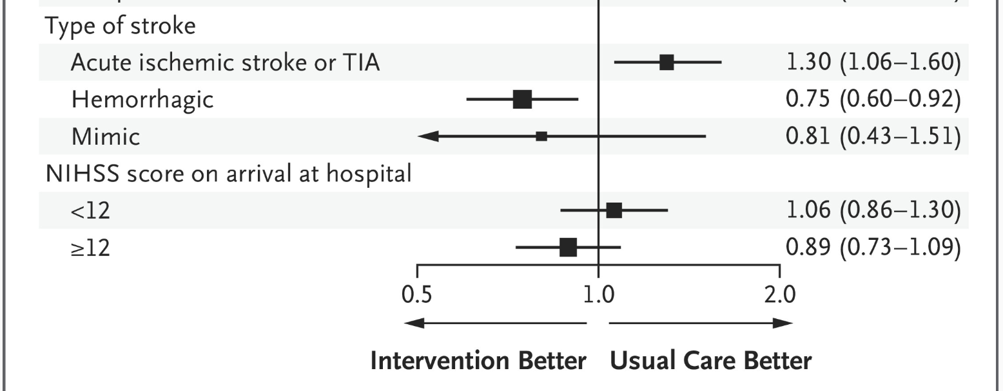
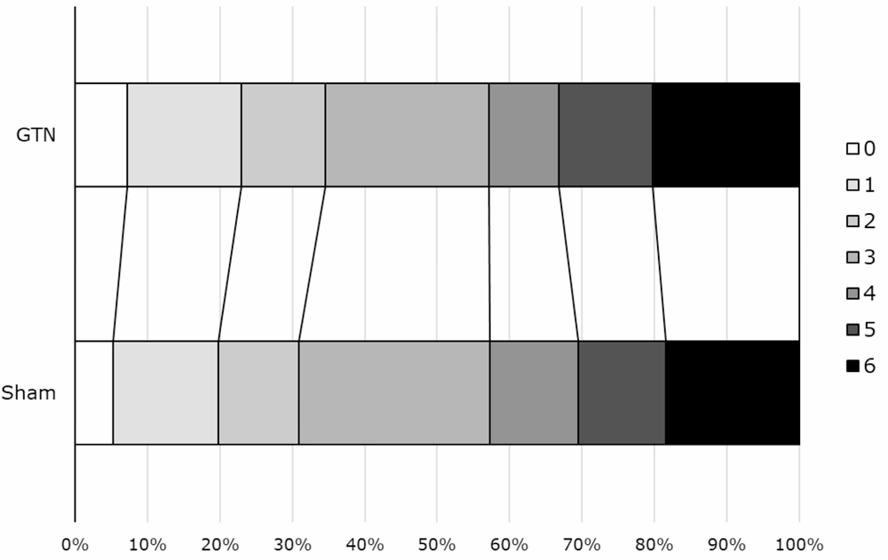
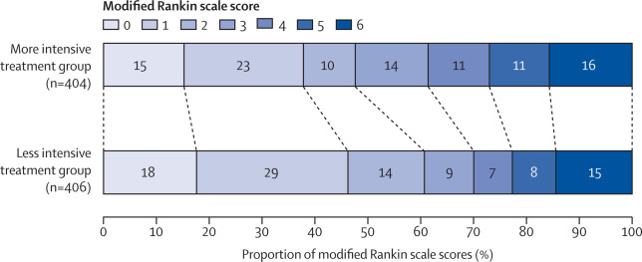
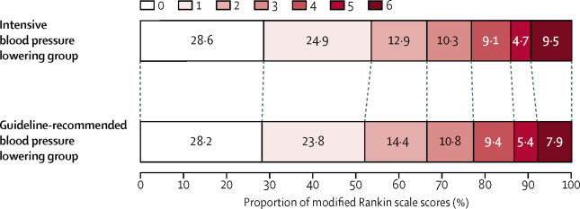
Emerging evidence suggests that intensive BP lowering does not improve outcomes
INTERACT4: Rapid initiation of intensive BP reduction had no benefit for AIS/TIA patients (n=2404)
RIGHT2: Glyceryl trinitrate(GTN) in the ambulance did not improve clinical outcomes despite lowering BP (n=597)
acOR 1.15, 95% CI 0.85-1.54, p=0.36
An open-label, randomized trial, aim to evaluate whether very early BP control in the ambulance improves outcomes among patients with acute stroke
A prospective, multicentre, ambulance-based RCT, aim to assess the effect of GTN given prehospital in patients with presumed stroke within 4 hours of onset
ENCHANTED: intensive BP lowing after IVT was not associated with a significant difference in functional recovery (n=2227)
ENCHANTED 2-MT: Intensive control of systolic BP should be avoided to patients who have received EVT (n=821)
Unadjusted OR 1·01, 95% CI 0·87–1·17, p=0·8702
cOR 1·37 [95% CI 1·07–1·76].
An international, randomised, open-label, blinded-endpoint, phase 3 trial. Intensive BP lowering compared with guideline-recommended BP lowering in patients treated with alteplase for acute ischaemic stroke.
A multicentre, open-label, blinded-endpoint, randomised controlled trial. Aim to compare the safety and efficacy of intensive BP lowering treatment versus less intensive treatment in patients after endovascular treatment.
3. Lancet 2019; 393: 877–88.
4. Lancet. 2022 Nov 5;400(10363):1585-1596.
1. N Engl J Med. 2024 May 30;390(20):1862-1872.
2. Stroke & Vascular Neurology 2024;9:e001634.
Notes:
Rapid declines or fluctuating blood pressure could compromise cerebral perfusion, particularly in patients with impaired cerebral autoregulation
thrombolysis is administered only if blood pressure decreases below the threshold values, which can result in the delayed initiation of treatment
and fewer patients receiving the treatment overall.

Slide 6
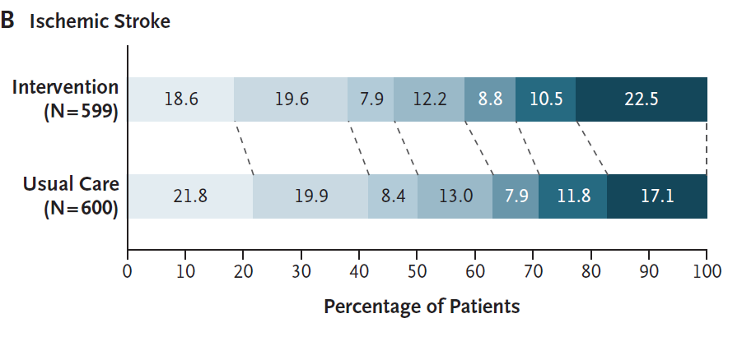
Emerging evidence suggests that intensive BP lowering does not improve outcomes
INTERACT4: Rapid intensive BP reduction was associated with poor functional outcome
ENCHANTED: intensive BP lowing after IVT was not associated with a significant difference in functional recovery
ENCHANTED 2-MT: Intensive control of systolic BP should be avoided to patients who have received EVT
OR:1.30; 95% CI: 1.06-1.60
OR:1·01, 95% CI 0·87–1·17, p=0·8702
OR: 1·37; 95%CI 1·07–1·76
An open-label, randomized trial, aim to evaluate whether very early BP control in the ambulance improves outcomes among patients with acute stroke
An international, randomised, open-label, blinded-endpoint, phase 3 trial. Intensive BP lowering compared with guideline-recommended BP lowering in patients (n=2227) treated with alteplase for AIS.
A multicentre, open-label, blinded-endpoint, randomised controlled trial. Aim to compare the safety and efficacy of intensive BP lowering treatment versus less intensive treatment in patients after endovascular treatment.
N Engl J Med. 2024 May 30;390(20):1862-1872.
Lancet 2019; 393: 877–88.
Lancet. 2022 Nov 5;400(10363):1585-1596.
Notes:
Rapid declines or fluctuating blood pressure could compromise cerebral perfusion, particularly in patients with impaired cerebral autoregulation
thrombolysis is administered only if blood pressure decreases below the threshold values, which can result in the delayed initiation of treatment
and fewer patients receiving the treatment overall.

Slide 7
Study Hypothesis
Implications of Recent BP Management Evidence
Although recent studies focused on patients with systolic BP below 180–185 mmHg, it remains uncertain whether the same trends apply to those with severely elevated BP.
Nevertheless, these findings consistently suggest that large and rapid blood pressure fluctuations should be avoided, as they may compromise cerebral perfusion and worsen outcomes.
Potential Risks of the ‘Lower BP before IVT’ Approach
Clinicians may feel pressured to lower BP quickly to meet guideline thresholds, leading to:
  Excessive or abrupt BP reduction → significant hemodynamic swings
  Risk of missing the thrombolysis window due to waiting
A novel concurrent strategy offers a potential solution
  Concurrent strategy, wherein thrombolysis is initiated immediately upon eligibility (in patients with SBP ≤220 mmHg) while antihypertensive therapy is started simultaneously, could dramatically shorten DNT times that is strongly correlated with improved functional outcomes and reduced disability.

Slide 8
Study Objective & Design
Objective: To establish whether a concurrent strategy of initiating thrombolysis and antihypertensive therapy is superior to a sequential strategy in the overall management of acute ischemic stroke
Study design: a Phase III, prospective, multicenter, randomized, controlled, open-label, blinded-endpoint (PROBE), superiority trial.
Concurrent treatment*
AIS < 4.5h with elevated BP (China: 180/100 mmHg; U.S./Canada/Europe: 185/110 mmHg), but below 220 mmHg.
NIHSS assessed
NIHSS & sICH assessed
NIHSS & sICH assessed
mRS and
EQ-5D-5L assessed
Sequential treatment#
V1
0-24h
before Treatment
V2
0h
Open-Label
V3
24h
after Tx
V4
72±12h
After Tx
V5
D7±1
/discharge
V6
D90±14
Screening and enrollment
Treatment
Follow up
*Concurrent arm: 1.Thrombolysis: Immediately after randomization, IVT (alteplase or tenecteplase) is administered as per local practice. 2.Antihypertensive Therapy: As soon as feasible after the start of thrombolysis, intravenous antihypertensive therapy is initiated with the goal of lowering blood pressure to below guideline recommended range (e.g. China: 180/100 mmHg; U.S./Canada/Europe: 185/110 mmHg).
#Sequential arm:1. Antihypertensive Therapy: Immediately after randomization, intravenous antihypertensive therapy is initiated to actively lower the patient's blood pressure to below the guideline recommended range. 2. Thrombolysis: Once the blood pressure is confirmed to be at or below the guideline recommended range, intravenous thrombolysis (alteplase or tenecteplase,) is administered

Slide 9
Study Endpoints
Primary endpoint: a hierarchical composite endpoint analyzed using the win ratio
  Rationale: The outcome of a stroke patient is multifaceted, involving a complex interplay between treatment efficacy, treatment-related harm, and the efficiency of the care process. A single endpoint, such as the modified Rankin Scale (mRS) alone, cannot capture this complexity. The win ratio is a patient-centered statistical method that allows for the comparison of treatment arms across several prioritized outcomes. It provides a more holistic assessment of the net clinical benefit. The hierarchy is ordered based on clinical importance:
  Functional Outcome (mRS): Defined as the distribution in scores on mRS at 90 days after randomization. This is the most important, patient-centered outcome. The comparison prioritizes who has a better functional status at 90 days.
  Major Safety (sICH): Defined as the sICH occurrence within 7 days after randomization (or until discharge, whichever comes first), based on SITS-MOST criteria. If functional outcomes are tied, the comparison defaults to the most critical safety event. The patient who avoids sICH wins.
  Process Efficiency (DNT): Defined as the time between emergency department arrival to thrombolysis start (DNT). If both efficacy and safety are tied, the final comparison is the primary mechanistic target of the intervention: treatment timeliness. The patient treated faster wins.
The primary analysis will be a win ratio of the hierarchical composite endpoint (90-day mRS, sICH, DNT). Patient pairs will be formed. Pairs that are tied on all three components of the endpoint will be treated as neutral ("ties"). The proportion of wins, losses, and ties will be reported. Win ratio with 95% confidence interval will be estimated as a measurement of treatment effect. Primary analysis will be based on the unadjusted win ratio approach.
mRS: modified Rankin Scale
sICH: symptomatic intracerebral hemorrhage
DNT: door-to-needle time
Notes:
选择序数分析作为主要终点，是基于以下几点证据充分的考量：
1.方法学优势：多个方法学研究证实，序数分析比任何二分法有更高统计效能，能更敏感地检测整体治疗效果，特别适合我们这种样本量有限的研究。
2.避免阈值争议：不同研究使用不同二分阈值导致结论不可比。我们的初步分析显示，治疗可能产生‘整体右移’效应，序数分析能捕捉这种模式，而二分法可能因阈值选择而错过。
3.全面反映患者获益：从5到4的改善对重症患者和医疗系统都有意义，序数分析赋予所有改善平等权重，更符合患者中心原则。
为平衡方法与临床需求，我们主要分析采用序数方法，但预设二分法（0-1、0-2）作为次要分析，增强临床解释。这样既能保证研究灵敏度，又能提供临床实用的结果。

Slide 10
Flowchart of win ratio method
Step1: Pairs setup
Step2: Comparison of all pairs
For all pairs
Treatment
Control
Win
Compare
mRS
Loss
Patient T₁
Patient C₁
T<C
T>C
Patient T₂
Patient C₂
Tie
Win
Compare
sICH
Loss
T: No
C: Yes
T: Yes
C: No
⋮
⋮
Tie
Patient Tₘ
Patient Cn
Win
Compare
DNT*
Loss
T<C
T>C
m × n Pairs
Tie
Win Counter +1
Tie Counter +1
Loss Counter +1
**Win Ratio = Win counter/ Loss Counter
* DNT: Door to needle time
** Win Ratio >1 favors treatment group based on pre-specified hierarchical outcomes

Slide 11
Study Endpoints
Secondary endpoints
  Excellent Functional Outcome: mRS score of 0–1 at 90 days.
  Good Functional Outcome: mRS score of 0–2 at 90 days.
  Distribution of Functional Outcome: The mRS score at 90 days
  EQ-5D-5L at 90 days.
  Neurological Status at 72 Hours: NIHSS score assessed between 72±12 hours post-randomization.
  Early Neurological Improvement: Defined as achieving an NIHSS score of 0–1 or a decrease of ≥4 points from the baseline NIHSS score at the 72±12 hour assessment.
  Mortality: All-cause mortality at 90 days.
  Malignant Cerebral Edema: The incidence of malignant edema within 7 days (or until discharge, whichever comes first) adjudicated by the central imaging core lab according to follow-up imaging and medical history.
  Process Metrics: DNT(Door-to-Thrombolysis Start Time), Door-to-Antihypertensive Start Time, Door-to-Target BP Time, Time-in-Range for SBP 140–180 mmHg, mean BP over 24 hrs.
Safety endpoints
  sICH occurrence within 7 days: The primary definition of sICH is based on SITS-MOST criteria (as used in the primary endpoint); The sensitivity analysis for sICH will use the NINDS definition.
  Hemorrhagic Event Classification: All follow-up imaging will be systematically assessed by the central core lab using the Heidelberg Bleeding Classification to categorize any hemorrhagic event.
  Any Intracerebral Hemorrhage: Any evidence of ICH on follow-up imaging up to 7 days.
  Early Mortality: All-cause mortality at 7 days and in-hospital mortality.
  Serious Adverse Events (SAEs) within 90 days.

Slide 12
Key Inclusion/Exclusion Criteria
Inclusion Criteria:
Age ≥18 years.
Clinical diagnosis of acute ischemic stroke.
With a clearly defined time of symptom onset or last known well, allowing for randomization within 4.5 hours.
The treating physician has made the decision to treat the patient with intravenous thrombolysis.
Elevated blood pressure, defined as: Pre-thrombolysis BP exceeds guideline-recommended range (e.g. China: 180/100 mmHg; U.S./Canada/Europe: 185/110 mmHg), but below 220 mmHg.
Informed consent is obtained from the patient or a legally authorized representative in accordance with local regulations. A deferred or waiver of consent model will be used where permitted by local ethics committees for emergency research.
Exclusion Criteria:
Any condition that, in the judgment of the investigator, would preclude follow-up or interfere with outcome assessment (e.g., end-stage malignancy, severe multi-organ failure).
The patient is pregnant or breastfeeding.
Concurrent enrollment in another interventional trial where the intervention is likely to confound the study endpoints.

Slide 13
Sample Size
The study will enroll 1,600 participants across China and potentially across multiple international sites (e.g. Canada and Netherlands).
Rank | Data type | Distribution | Parameters | What to simulate? | Intervention A | Control B | Direction
 |  |  | Dropout rate |  | D_{A}=.10 | D_{B}=.10
1 | Ordinal | Multinomial | Percentage distribution of mRS | Multinomial (0,1,2,3,4,5,6) | π11A=0.23 π12A=0.22 π13A=0.17 π14A=0.14 π15A=0.08 π16A=0.10 π17A=0.06 | π11B=0.22 π12B=0.19 π13B=0.13 π14B=0.16 π15B=0.13 π16B=0.08 π17B=0.09 | Smaller value /Smaller π₁, better (win)
2 | Binary | Binomial | Probability of sICH | Binary outcome (0 and 1) | π_{2A}=0.10 | π_{2B}=0.13 | Smaller value /Smaller π₂, better (win)
3 | Continuous | Normal | Mean and SD | Normal outcome | µ_{3A}=64 σ_{3A}=33.87 | µ_{3B}= 75.7 σ_{3B}= 33.87 | Smaller value /Smaller µ₃, better (win)
Analysis method | No of Simulations | Sample Size | Dropout Rate | Win Ratio | Power
Win ratio | 1000 | 1600 | 0.1 | 1.217 | 0.896
Notes:
HOPE: 40.3% vs. 26.3%

Slide 14
Interim Safety Monitoring
The trial will be conducted under the oversight of an independent Data and Safety Monitoring Board (DSMB).
Scheduled Reviews: The DSMB will convene to review cumulative data after approximately 400 and 800 participants have completed their 7-day follow-up.
Monitoring Focus: The primary focus will be on all-cause mortality at 7 days. The DSMB will also be requested to look at sICH rates closely during the interims.
Stopping Guidelines for Harm: The DSMB will use a conservative Haybittle–Peto boundary (p < 0.01 for harm) for all-cause mortality at 7 days to guide any recommendation for early trial termination.

Slide 15
Timeline
Task | Timeline (best case) | Timeline (base case)
Proposal approval and release | Feb-Apr 2026 (local) May-Jul 2026 (global) | Feb-Apr 2026 (local) May-Jul 2026 (global)
CTP approval and release | Aug-Sep 2026 | Aug-Sep 2026
EC | Sep-Oct 2026 | Oct-Nov 2026
Contract sign | Sep-Oct 2026 | Oct-Dec 2026
SIV | Nov 2026 | Jan 2027
FPI | Nov 2026 | Jan 2027
LPI | Oct 2028 | Dec 2028
LPO (3m follow-up) | Jan 2029 | Mar 2029
Data analysis and CTR | Apr 2029 | Jun 2029

Slide 16
Study visit
Assessment / Activity | T0 (Arrival → Intervention) | T24 (18–36 h) | T72 (48–96 h) | Discharge(or Day 7) | Day 90 (+/- 14 days)
Eligibility & Baseline Data | X
Randomization & Intervention | X
NIHSS Assessment | X |  | X
Follow-Up Imaging (for Core Lab) |  | X | X
Blinded Modified Rankin Scale (mRS) Assessment |  |  |  |  | X
sICH, malignant cerebral edema, and any intracerebral hemorrhage Assessment |  |  |  | X
Collect Serious Adverse Events (SAEs) Only | X | X | X | X | X
Process Metrics Data Collection | X

Slide 17
Considerations for Supporting the Current Study
Fulfill unmet needs
  Nearly 30% of AIS patients present with a SBP ≥180 mmHg. Current guidelines recommend BP＜180/100 mmHg or BP＜185/110 mmHg prior to IVT
  Adhering to current guideline necessitates a sequential management pathway, but time is brain, the therapeutic benefit of IVT is unequivocally time-dependent
  A novel concurrent strategy, wherein thrombolysis is initiated immediately upon eligibility (in patients with SBP ≤220 mmHg) while antihypertensive therapy is started simultaneously, offers a potential solution
  Data gap filling
  The current study might provide confirmatory evidence to compare the efficacy, safety, and efficiency of the concurrent versus the sequential approach to thrombolysis administration and BP management
  The potential use of TNK/rtPA in concurrent strategy
  Potential to reshape treatment protocols and inform guideline
  Potential to remove Metalyse/Actilyse contraindications for hypertension pts (SBP＞185 or DBP ＞110 mmHg).
For PEC Endorsement: Concept, timeline and budget (3M)

Slide 18
Thank you ！

Slide 19



Committee
Prof. Wu Bo
West China Hospital Sichuan University, China
Prof. Bijoy Menon
Cumming School of Medicine, University of Calgary, Calgary, AB, Canada
Statistical guidance – Prof. Duolao Wang
Biostatistics Unit, Liverpool School of Tropical Medicine,
Liverpool, UK

Slide 20
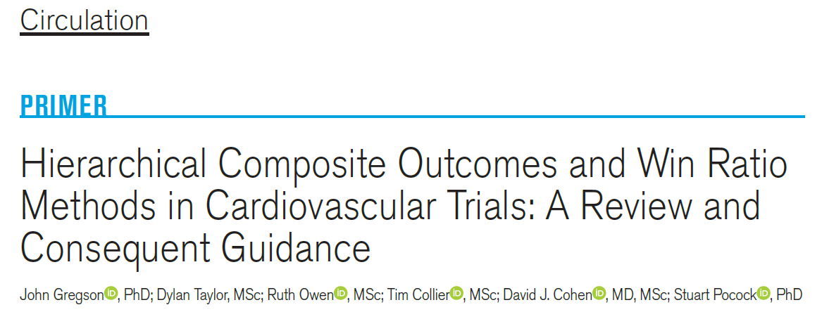
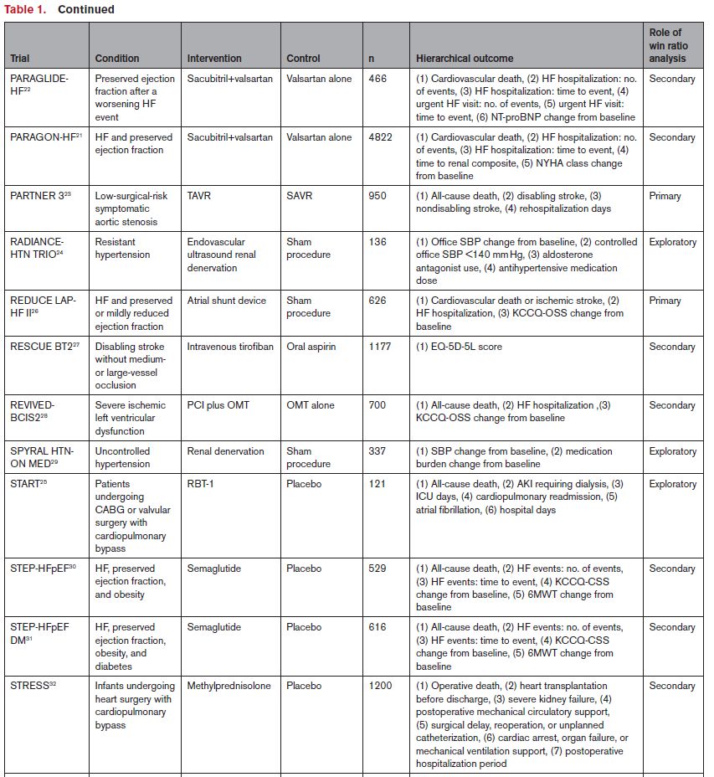
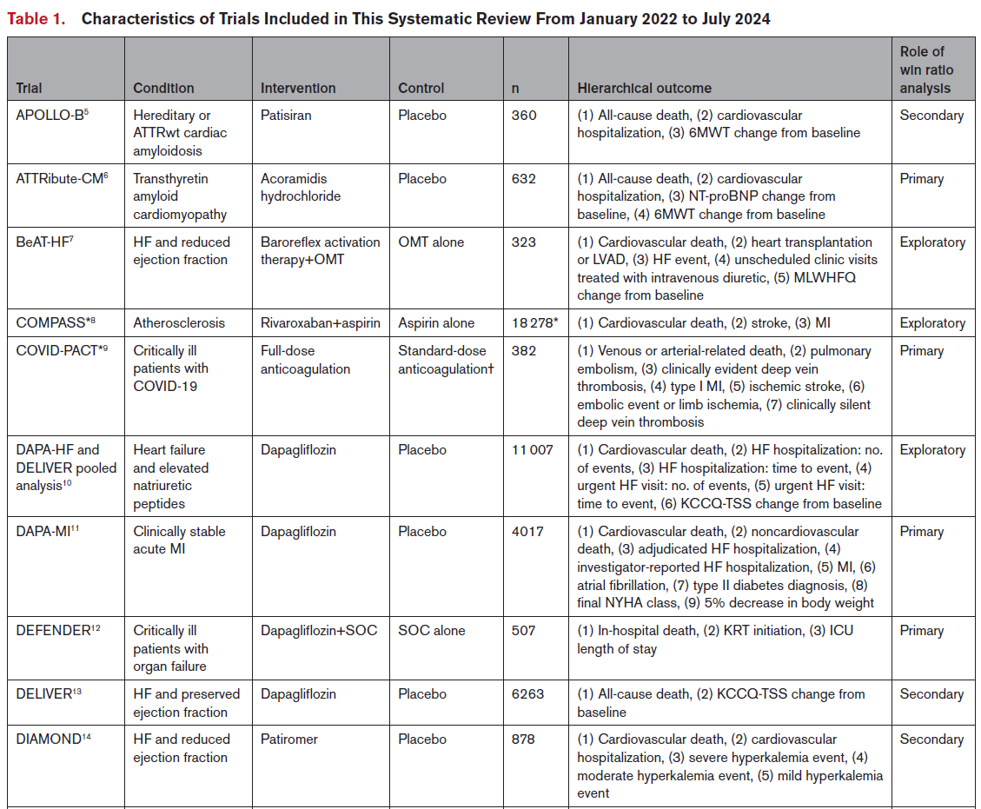
Hierarchical composite outcome has been most widely used in RCTs in cardiovascular disease
IF 38.5
N Engl J Med
N Engl J Med
N Engl J Med
Lancet
mRS and EQ-5D-5L score
N Engl J Med
Circulation
JAMA
N Engl J Med
N Engl J Med
N Engl J Med
Circulation. 2025;151:1606–1619.

